Slide 1
Windows Azure platform academic pass
Getting Started Guide

Slide 2
Congratulations
Congratulations on your Windows Azure Educator Grant!
The following slides offer a step-by-step guidance on how to redeem your Windows Azure platform academic pass.
Please have your 12 character pass code ready when you start the process.
We hope you will enjoy your experience with the Windows Azure platform.
Windows Azure in Education Team

Slide 3
Step #1 – Ensure email won’t be blocked
Add admin@windowsazurepassadmin.com to your email contact list to ensure all email communications are not blocked by your SPAM/Junk filters.

Slide 4
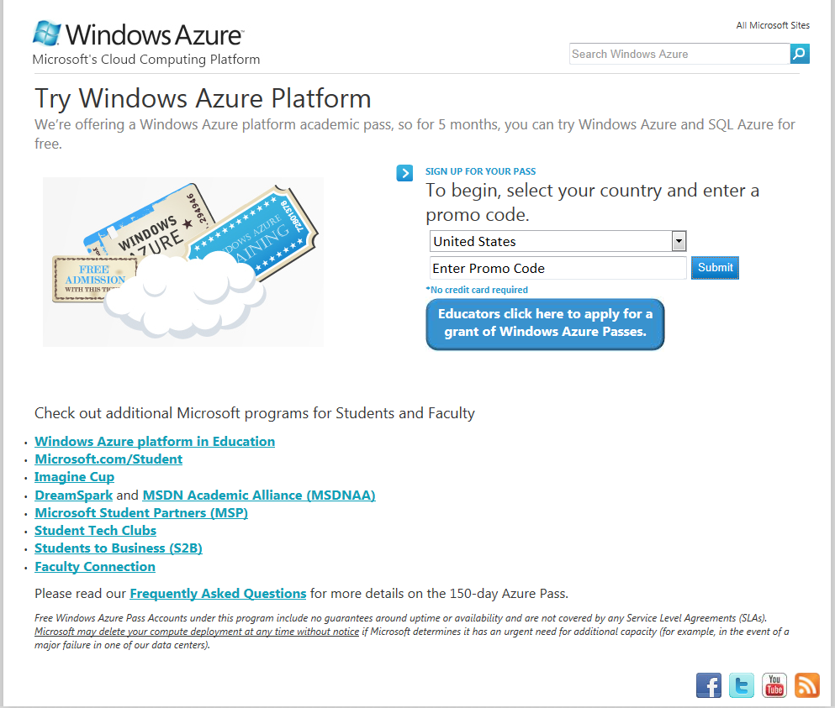
Step #2 - Redeem Your Pass Go to www.WindowsAzurePass.com/azureu
Includes the following resources:
Windows Azure
3 small compute instances
3GB of storage
250,000 storage transactions
SQL Azure
Two 1GB Web Edition database
AppFabric
100,000 Access Control transactions
2 Service Bus connections
Data Transfers (per region)
3 GB in
3 GB out

Slide 5
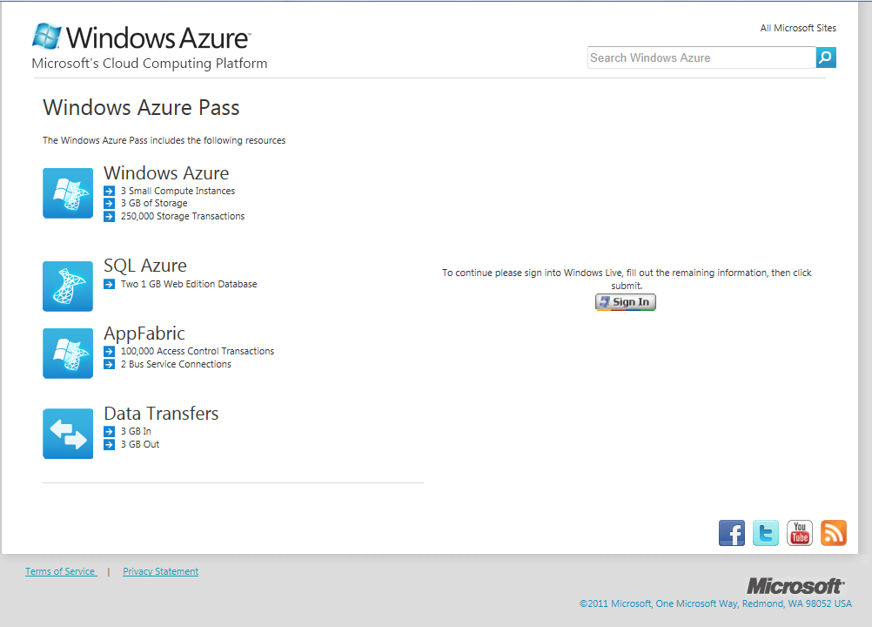
Step #2 – Sign in

Slide 6
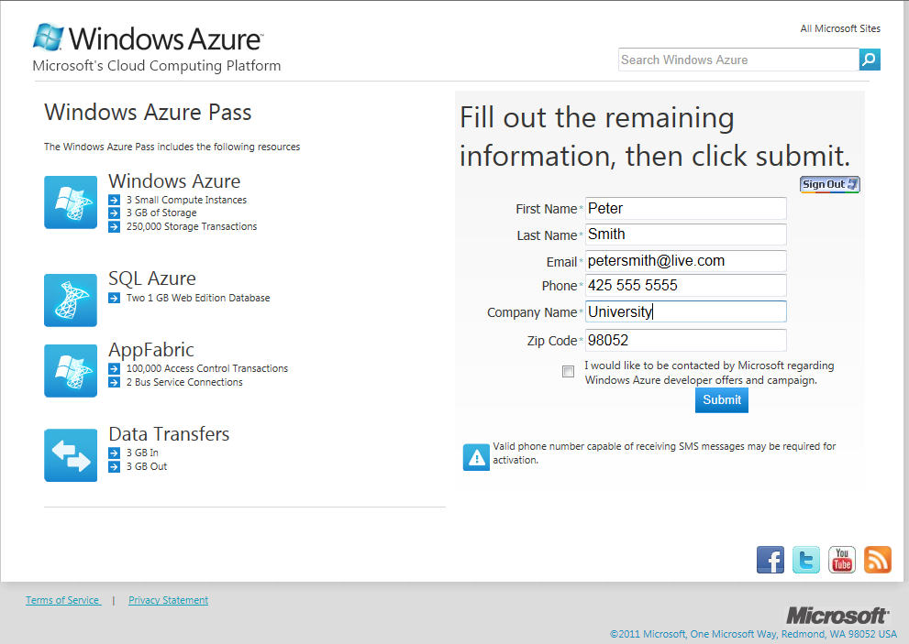
Step #3 – Register and redeem your code
PLEASE NOTE:
Pass is valid for 150 Days from the date when your account is activated.
All DATA is WIPED at end of 150 Days
Reminder/expiration warning emails will be sent
T-15 days
T-10 days
T-3 day
T-1 day

Slide 7
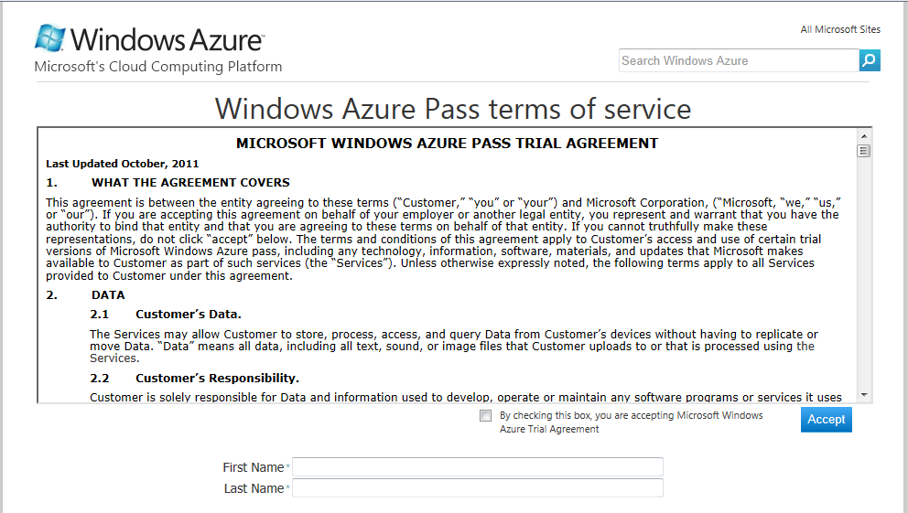
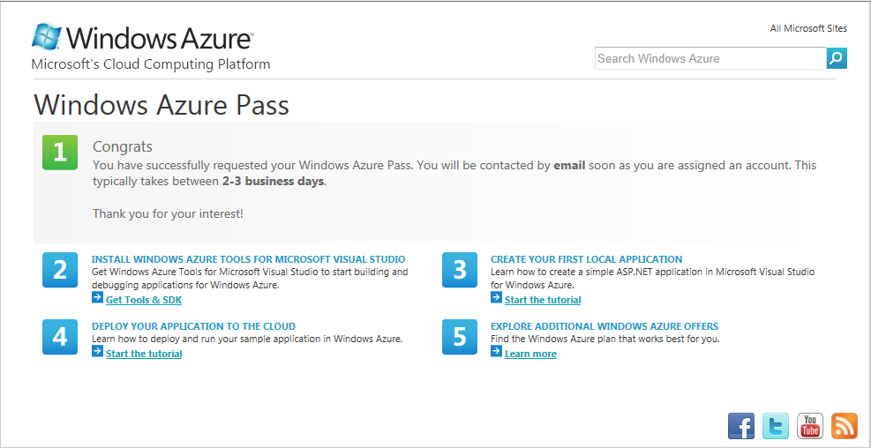
Step #4 – Accept Terms of Use
Terms of Use Agreement Page
Successful Registration Page

Slide 8
Email #1 - Confirmation: Request Received
Subject: Windows Azure Pass request
Dear [Name]
Thank you! Your Windows Azure Pass request has been accepted.
You should receive your login in 2-3 business days. If you do not receive your login, first try logging into the Windows Azure Management console at www.WindowsAzure.com with the Windows LiveID you used when redeeming your pass. If this does not work then please email us at AzureU@microsoft.com with your full name, Windows LiveID, and your Institution name.
In the meantime, feel free to familiarize yourself with the Windows Azure platform so that you can hit the ground running:
- Download Windows Azure Tools and start building your applications.
- Learn how to create an ASP.NET application.
- See how to deploy and run your sample application.
Thank you,
The Windows Azure in Education Team
Review the Windows Azure Pass Privacy Policy and Terms of Use.

Slide 9
Email #2 - Account Activated
Subject: Your Windows Azure Pass is active!
Dear [name]
Congratulations! Your Windows Azure Pass has been activated.
To get started, sign into the developer portal using your Windows Live ID.
If you would like to purchase a Windows Azure subscription please visit {Transition Link(Azure Account)}.
Keep in mind, if you choose not to convert your account to a paid subscription your pass will expire on [ExpirationDate], at which time all of your data will be erased. Please be sure to move any applications or data before your trial expires.
We hope you enjoy your Windows Azure experience.
Thank you,
The Windows Azure in Education Team
Review the Windows Azure Pass Privacy Policy and Terms of Use.

Slide 10
Email #3, 4, 5, 6 - Pass Expires in 15/10/3/1 day(s)
Subject: Expiration Notice: Your Windows Azure Pass
Dear [name]
Your Windows Azure Pass will expire on [ExpirationDate].
If you would like to purchase a Windows Azure subscription please visit [Transition Link].
Keep in mind, if you choose not to convert your account to a paid subscription all of your data will be erased when your pass expires. If you choose not to extend your Pass, please be sure to back up or migrate your data.
We hope you are enjoying Windows Azure, and have discovered its many powerful features.
Thank you,
The Windows Azure in Education Team
Review the Windows Azure Pass Privacy Policy and Terms of Use.

Slide 11
Email #7 - Your Pass has expired
Subject: Your Windows Azure Pass has expired
Dear [name]
Your Windows Azure Pass has expired and all of your data has been erased.
To continue using the Windows Azure platform, please select from one of our current offers.
Thank you for trying the Windows Azure platform!
The Windows Azure in Education Team
Review the Windows Azure Pass Privacy Policy and Terms of Use.

Slide 12
Need support?
For technical issues, please leverage the support channels available to you here:
http://www.windowsazure.com/en-us/support/contact/
For all other issues, please contact AzureU@microsoft.com

Slide 13
Azure Learning Materials
Get the Tools
Download Windows Azure Tools for Microsoft Visual Studio
Download Microsoft Web Platform Installer
Dig Deeper into the Windows Azure Platform
Download the Windows Azure Platform Training Kit
Visit the Cloud Developer Center on MSDN
Windows Azure Platform code samples on Code Plex (open source code)
Use the online training below to learn more about the Windows Azure Platform:
Curriculum Resources - Azure Curriculum Resources
Build your first Windows Azure Application following this Quick Start Tutorial
Learn why Windows Azure is a great cloud computing platform with these fun videos
View the series of Web seminars designed to quickly immerse you in the world of the Windows Azure Platform
Learn about SQL Azure Database video
Learn about PHP on Windows Azure

Slide 14


Microsoft programs for Students and Faculty
Microsoft.com/student
Imagine Cup
DreamSpark
MSDN Academic Alliance (MSDNAA)
Microsoft Student Partners (MSP)
Student Tech Clubs
Students to Business (S2B)
Faculty Connection
Windows Academic Program

